Slide 1
Thick Data Analytics for Detecting IBD Based on Vision Transformers
Abel Andrés Serracín Martínez ID:1227614
Supervised by:
Dr. Sabah Mohammed, Dr. Jinan Fiaidhi
Computer Science Department, Lakehead University
Thunder Bay, Canada
Emails:
aserraci@lakeheadu.ca, sabah.mohammed@lakeheadu.ca, jinan.fiaidhi@lakeheadu.ca

Slide 2

Agenda
Introduction
Research Objectives
Related Work
Vision Transformers Overview
Dataset Overview
Siamese Neural Networks
YOLO-Based ROI Detection
Adaptive Transformers
Conclusion
Future Work
Acknowledgements
Q & A

Slide 3
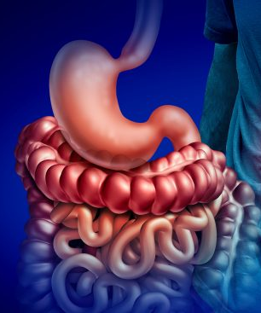
Introduction
IBDs are a significant global health challenge that requires early diagnosis.
Traditional diagnostic methods are invasive and expensive.
AI-driven techniques offer non-invasive and rapid diagnostic alternatives.
Notes:
Inflammatory Bowel Diseases (IBD), including Crohn’s disease and ulcerative colitis, are challenging to diagnose due to reliance on invasive procedures like endoscopy. Recent advances in deep learning, especially Vision Transformers (ViTs), offer promise for improved, non-invasive diagnostic tools. However, their effectiveness can be limited by small datasets. This study explores combining ViTs with thick data techniques—rich, qualitative methods that enhance model training on limited data—to improve IBD detection accuracy using medical imaging.

Slide 4

Research Objectives
Main Research Question:
“How can we improve the work of vision transformers using thick data approaches?”
Siamese Neural Networks for few-shot learning
YOLO Techniques
Three approaches:
Adaptive Transformers

Slide 5
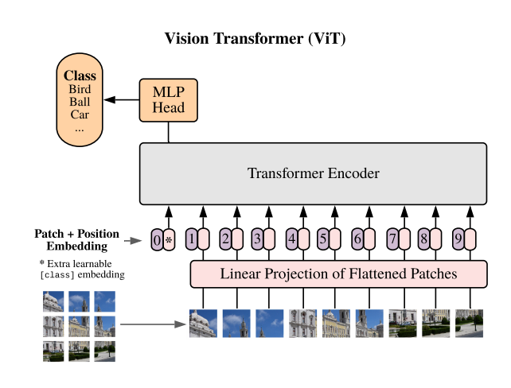
Related Work: Vision Transformers (ViTs)
ViTs outperform CNNs in medical imaging tasks requiring global spatial understanding.
They analyze image patches using self-attention to detect subtle IBD patterns.
Self-supervised models like DINO reduce dependency on labeled medical data.
Spatial Transformer Networks (STNs) improve robustness by focusing on relevant image regions.
These transformer-based models offer accurate, non-invasive tools for early IBD diagnosis.
Notes:
Vision Transformers (ViTs) have emerged as powerful tools in medical imaging, outperforming CNNs in tasks requiring global context, such as IBD detection. ViTs analyze images as sequences of patches, using self-attention to identify subtle inflammation and mucosal changes in colonoscopy images. Advanced models like Swin Transformer enhance this with multi-scale feature extraction, while DINO applies self-supervised learning to leverage unlabeled data—crucial in medical domains with limited annotations. Complementing ViTs, Spatial Transformer Networks (STNs) improve robustness by aligning and focusing on diagnostically relevant regions. Together, these models offer promising advancements in accurate, non-invasive IBD diagnosis.

Slide 6
Dataset Overview
Dataset: Kvasir v2
A collection of gastrointestinal endoscopic images.
Contains diverse diagnostic classes (e.g., polyps, ulcerative colitis).
Expert-labeled images; limited sample size necessitates data augmentation.
Emphasis on ROI extraction to improve model focus and performance.

Slide 7
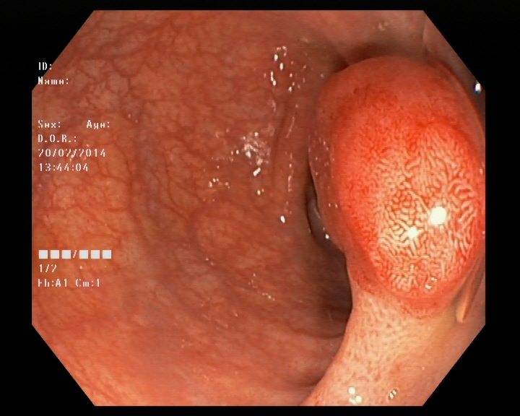
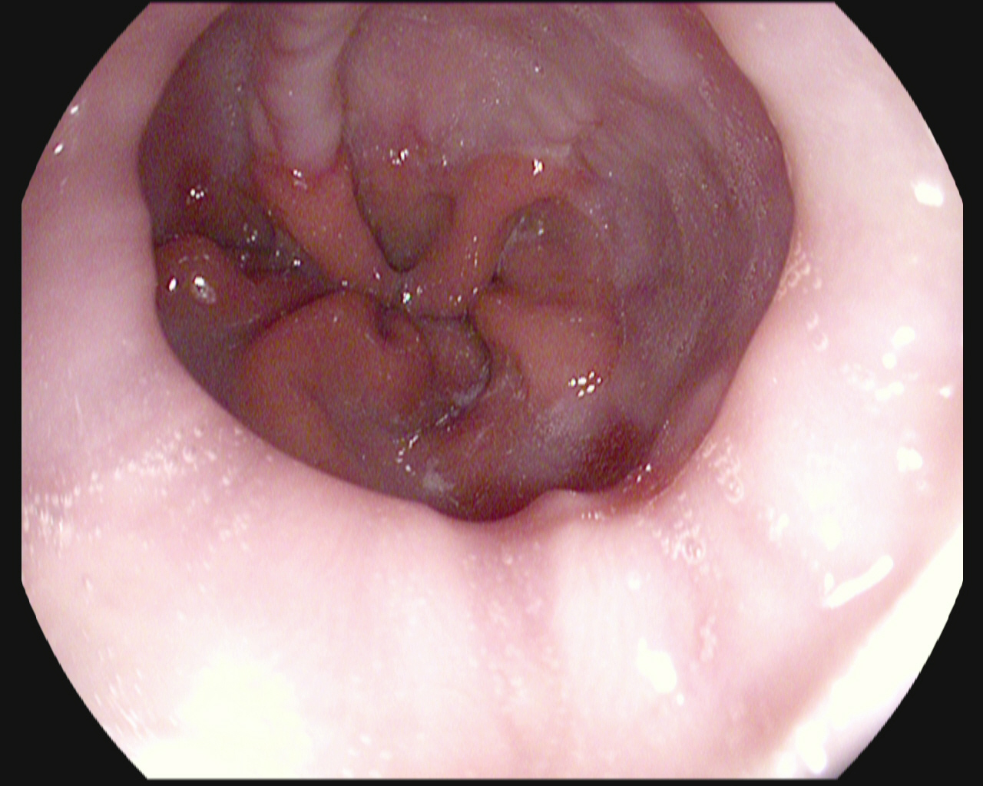
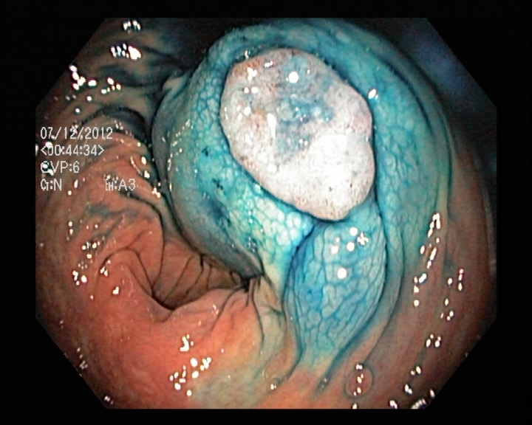
Example classes of the Kvasir-V2 dataset
Polyps
Esophagitis
Dyed lifted Polyps

Slide 8
What if we used Siamese Neural Networks for one-shot or few-shots learning?

Slide 9
What is a Siamese neural network?
Few-Shot Learning with Twin Neural Networks (Siamese Networks)
Siamese networks use shared weights to compare two inputs and learn their similarity.
Ideal for One-Shot or Few-Shot learning in cases with limited labeled medical data.
Should be trained on common classes like ulcerative colitis, dyed-resection-margins, and normal anatomical areas.
Can generalize to rare IBD conditions (e.g., polyps) using just a few examples.
Learns to differentiate new or uncommon conditions by comparing them against known image classes.

Slide 10
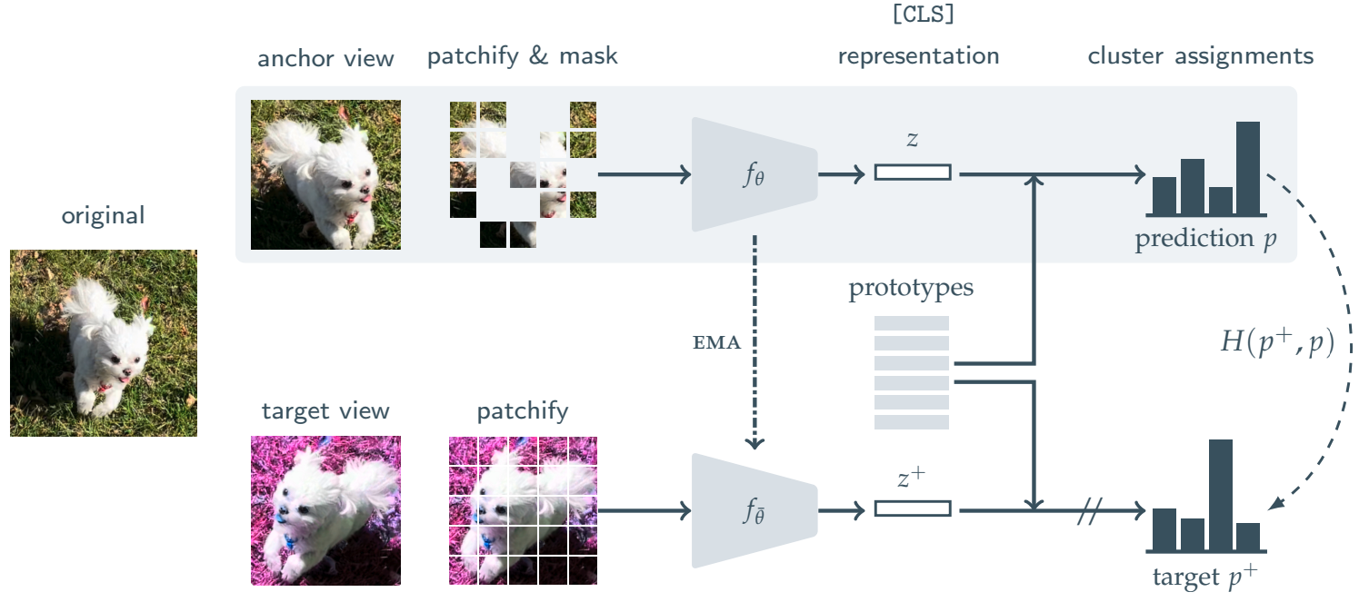
Few-Shot Learning for IBD Classification using ViTMSN
Objective:
Classify polyps from endoscopic images using few-shot learning.
Approach:
Use ViTMSN (Masked Siamese Network) pre-trained on ImageNet.
Pre-train on all Kvasir-V2 classes except polyps.
Introduce polyps through few-shot training (1 to 10 examples).
Why ViTMSN?:
Learns rich semantic features via masked self-supervised learning.
Ideal for low-data medical imaging scenarios.
Flexible transformer backbone with high generalization power.

Slide 11
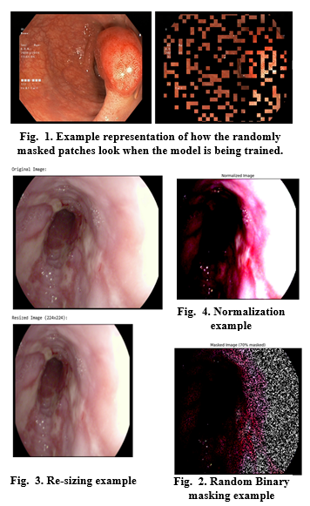
Preprocessing Pipeline
Several sequential transformations prepare images for self-supervised learning. Initially, the process loads an RGB image from the dataset. The first preprocessing step resizes this image to a fixed dimension of 224×224 pixels, standardizing input size for the ViT architecture. Next, the resized image undergoes normalization, where pixel values are converted to tensors and standardized using ImageNet statistics (mean=[0.485, 0.456, 0.406], std=[0.229, 0.224, 0.225]).
Notes:
Several sequential transformations prepare images for self-supervised learning. Initially, the process loads an RGB image from the dataset. The first preprocessing step resizes this image to a fixed dimension of 224×224 pixels, standardizing input size for the ViT architecture. Next, the resized image undergoes normalization, where pixel values are converted to tensors and standardized using ImageNet statistics (mean=[0.485, 0.456, 0.406], std=[0.229, 0.224, 0.225]).

Slide 12
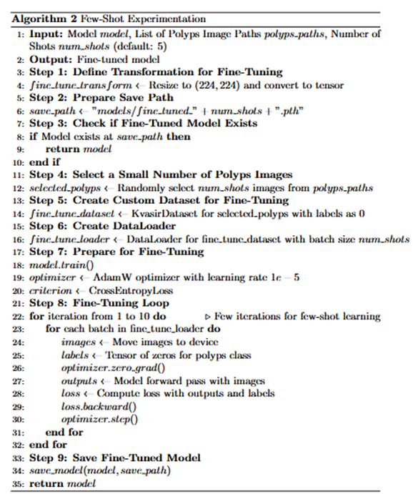
Few-Shot Learning and Fine-Tuning Process
Base Model Training
Initial Fine-Tuning (Base Model)
Dataset excluded the polyp class
Few-Shot Experiment Setup
Polyp class added during Few-Shot tuning
Built on top of the already fine-tuned base model
Experimentation Function (Algorithm 2)
Central function handling Few-Shot fine-tuning
Repeats fine-tuning process for 10 iterations
For each iteration:
Batches fetched from DataLoader
Moved to computational device (e.g., GPU)
Forward pass executed
Loss calculated & backpropagation applied
Optimizer updates model parameters
Saves model at each amount of shots

Slide 13
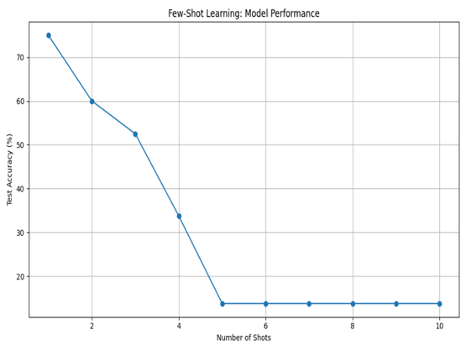
Few shot learning results
Despite expectations, performance drops with more data. The model excels in one-shot learning but struggles as more examples are added possibly due to needing greater amounts of data when the variety of the data is higher.
Shots | Accuracy(%)
1 | 75
2 | 60
3 | 52.5
4 | 33.75
5 | 13.75
6 | 13.75
7 | 13.75
8 | 13.75
9 | 13.75
10 | 13.75
Notes:
This performance pattern is particularly noteworthy because it differs substantially from what we typically expect in machine learning, where additional training data usually improves model performance. The dramatic decline in accuracy suggests that the Siamese Neural Network architecture, while highly effective at one-shot learning, may struggle to effectively integrate information from multiple examples.

Slide 14
What if we used YOLO approaches to zoom into region of interests?

Slide 15
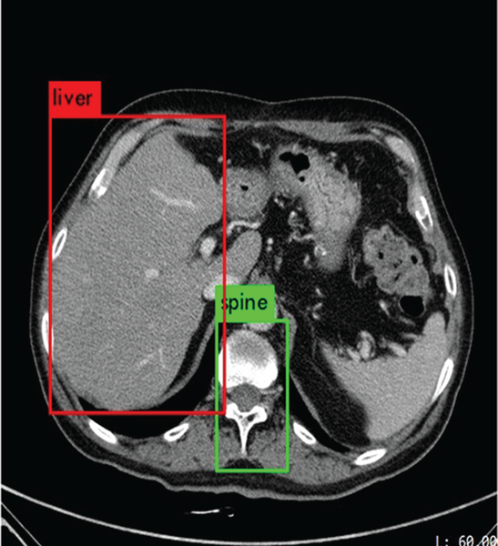
Integrating YOLO techniques with ViTS
Preprocessing: Grayscale, Gaussian blur, Otsu’s thresholding (OpenCV).
ROI Extraction: Largest contours cropped to reduce noise.
Augmentation: Flip, rotate, noise, brightness (Albumentations).
Processing: Hugging Face ViTImageProcessor.
Training: Fine-tuned ViT using AdamW + Early Stopping.
Implementation:
Use YOLO techniques and Regions of Interest (ROIs) detection, then feed refined regions to ViT for classification.

Slide 16
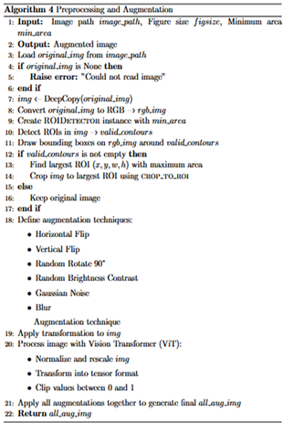
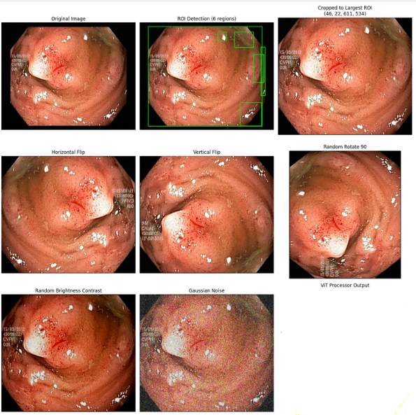
Preprocessing and Augmentations

Slide 17
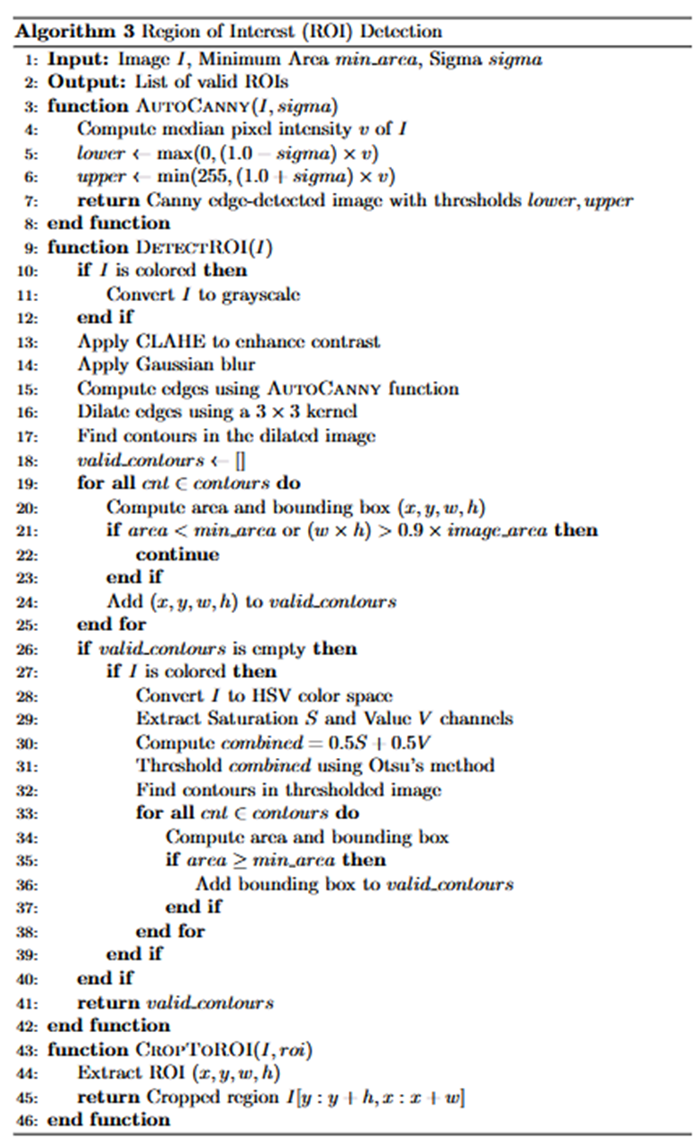
Region of Interest detection
This class detects regions of interest (ROIs) in images using edge detection and contour analysis. It applies auto-tuned Canny edge detection, enhances contrast with CLAHE, and filters contours by size to isolate meaningful areas. If no valid contours are found, it analyzes color variations in the HSV space. The crop_to_roi function then extracts the identified region, effectively focusing on key areas while minimizing noise.

Slide 18
YOLO-ROI: Experimental Results
Class | Precision | Recall | F1Score
dyed-lifted-polyps | 0.8182 | 0.36 | 0.5
dyed-resection-margins | 0.608 | 0.915 | 0.7305
esophagitis | 0.5686 | 0.725 | 0.6374
normal-cecum | 0.9296 | 0.33 | 0.4871
normal-pylorus | 0.9401 | 0.785 | 0.8556
normal-z-line | 0.6541 | 0.605 | 0.6286
polyps | 0.4136 | 0.385 | 0.5637
ulcerative-colitis | 0.7238 | 0.38 | 0.4984
Results
macro avg | 0.707 | 0.6231 | 0.6126
weighted avg | 0.707 | 0.6231 | 0.6126
accuracy | 0.6231
Class | Precision | Recall | F1Score
dyed-lifted-polyps | 0.9484 | 0.735 | 0.8282
dyed-resection-margins | 0.8611 | 0.93 | 0.8942
esophagitis | 0.6364 | 0.55 | 0.4516
normal-cecum | 0.8288 | 0.92 | 0.8728
normal-pylorus | 0.8608 | 0.855 | 0.8615
normal-z-line | 0.5874 | 0.84 | 0.6941
polyps | 0.8382 | 0.725 | 0.7775
ulcerative-colitis | 0.7676 | 0.925 | 0.8398
Results
macro avg | 0.792 | 0.785 | 0.7769
weighted avg | 0.792 | 0.785 | 0.7769
accuracy | 0.785
In Experiment 2, the model achieved higher precision and recall across most classes compared to Experiment 1. Notable improvements were seen in recall for dyed-lifted-polyps, normal-cecum, and polyps—classes that previously had low recall values. Ulcerative-colitis recall rose to 92.5%, and normal-cecum performance also improved significantly.
Experiment 1 results
Experiment 2 results
Notes:
These gains indicate that the ROI-based YOLO model, enhanced with auto-tuned Canny edge detection, better isolates key features, resulting in more accurate and consistent classification across diverse IBD image types.

Slide 19
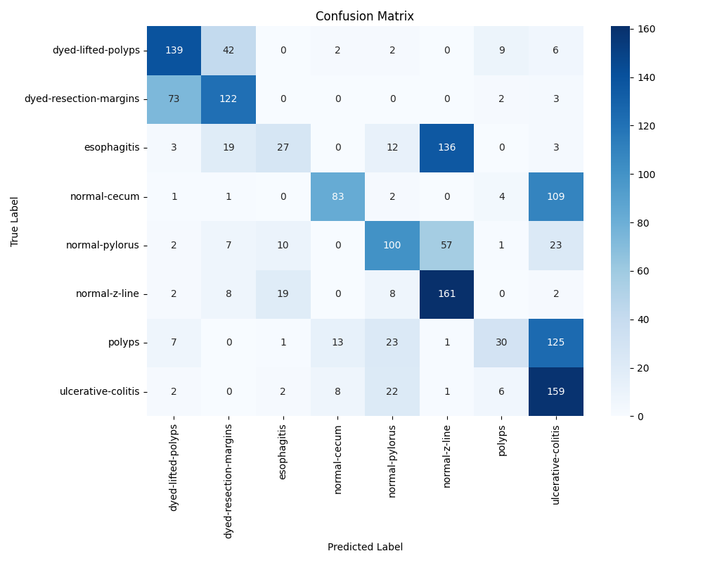
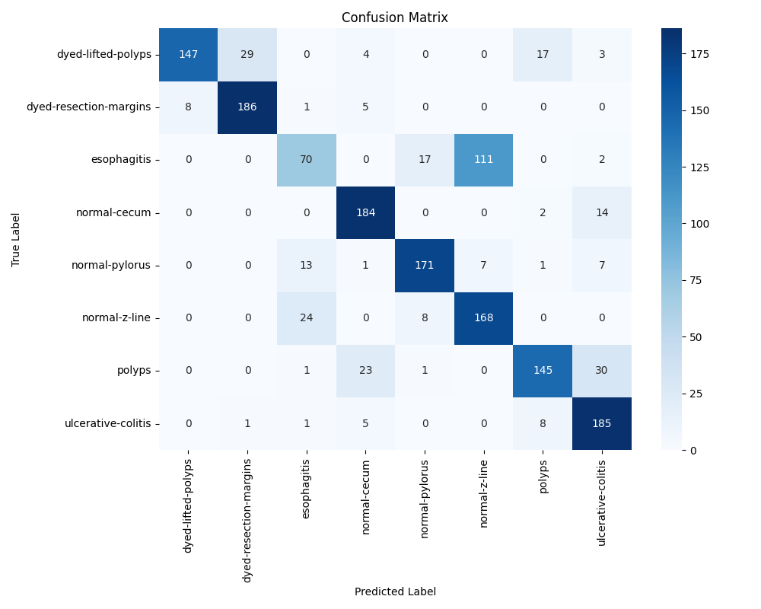
Confusion matrix of both experiments
Experiment 1
Experiment 2
Notes:
Looking at the confusion matrices, experiment 2 shows a more concentrated diagonal pattern compared toexperiment 1 , indicating better classification performance across all categories. In contrast, the previous experiment suffered from significant confusion between classes, particularly in categories like dyed-lifted-polyps, esophagitis, normal-cecum, and polyps, where a substantial number of samples were misclassified.

Slide 20
What if we used Adaptive Transformers?

Slide 21
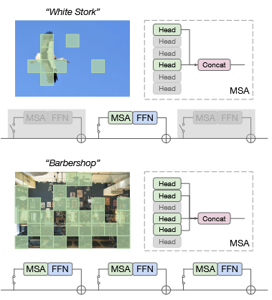
What are adaptive transformers?
A type of transformer model that dynamically adjust their computational effort during inference based on the complexity of the input.
The goal is to make deep learning models more efficient by skipping unnecessary computations for simpler inputs while still maintaining high accuracy for complex ones.
So, in other words “adapting” the computations according to the current “needs” depending on the inputs.
Notes:
The key innovation of Adaptive transformers is that as an image moves through the network, the number of tokens decreases, focusing computation only on the most important parts of the image.

Slide 22
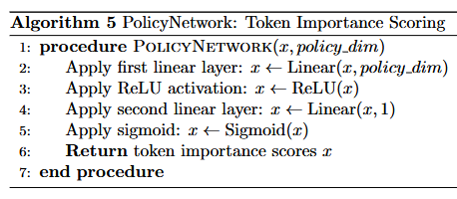
Adaptive Transformers: Architecture & Algorithms
For our experiment, this time we largely base our model on the example set by L. Meng et al., “AdaViT: Adaptive Vision Transformers for Efficient Image Recognition”, we will go over the main classes that contain all the “bells and whistles” of experimental model. First, we have PolicyNetwork, a small neural network that evaluates the importance of each token.
Notes:
it takes token embeddings as input and projects them to a lower dimension (policy_dim). Applies a ReLU activation and then projects back to a single value. It then applies the second layer which uses the sigmoid activation produces scores between 0 and 1, indicating token importance. Higher scores mean the token contains more valuable information. The PolicyNetwork is crucial because it's the "decision maker" that determines which tokens to keep and which to discard.

Slide 23
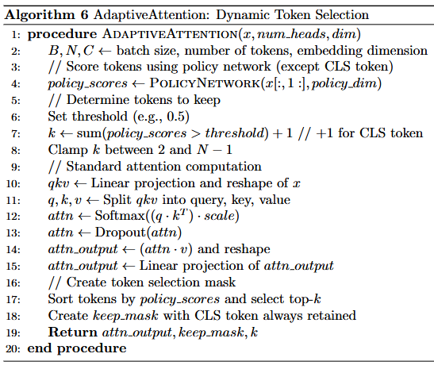
AdaptiveAttention class
This class combines standard self-attention with dynamic token selection.
it uses the PolicyNetwork to score all tokens
Then it determines how many tokens to keep based on a threshold
Then it processes all tokens in parallel through standard self-attention by computing queries, keys and values.
After attention is computed, it creates a mask to select only the most important tokens.

Slide 24
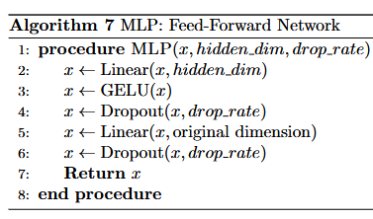
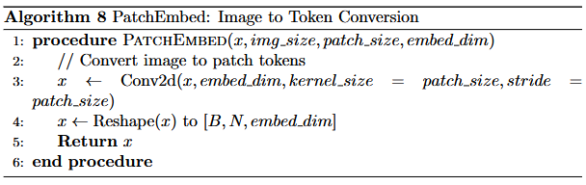
MLP and PatchEmbed classes
We have a standard Multilayer perceptron it projects the input to a higher dimension, applies a GELU activation function, and then projects backDropout is applied for regularization, this MLP processes tokens after they've been filtered by the AdaptiveAttention class.
The patch embedding layer converts an image into tokens, it does this by using a convolutional layer with kernel and stride equal to the patch size. This effectively divides the image into non overlapping patches; Each patch is projected to the embedding dimension. The output is then reshaped to form a sequence of patch tokens.

Slide 25
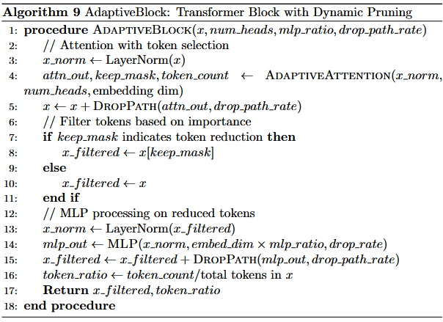
AdaptiveBlock class
Is a complete transformer block with dynamic token pruning.
applies layer normalization and adaptive attention based on the keep_mask value
Filters out less important tokens
Then processes the filtered set through another layer normalization and the MLP
Tracks and returns the token retention ratio for monitoring.
As tokens pass through multiple blocks, their number progressively decreases.

Slide 26
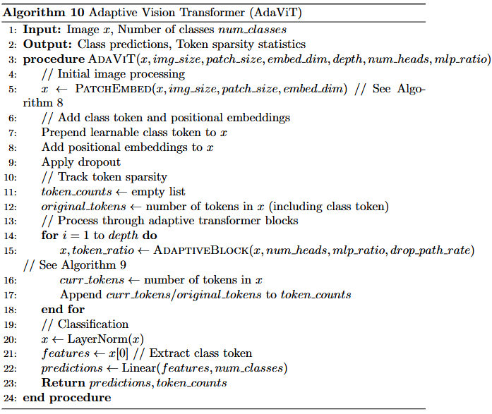
AdaViT class
It initially converts the image to patch tokens using PatchEmbed
Adds a class token and positional embeddings
It then progressively reduces the converted image tokens by passing them through a series of AdaptiveBlocks
Keeps track of token retention at each layer
Performs classification after all blocks by applying layer normalization then extracting the class token

Slide 27
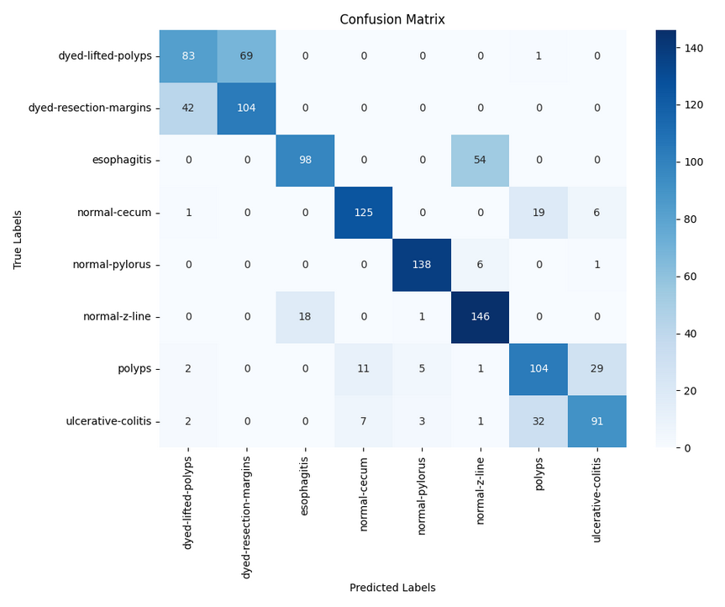
Adaptive Transformers: Experimental Results
The model performs especially well in identifying the “normal” classes with high accuracy.
These results suggest that the model effectively captures distinct and well-defined features.
In contrast, classes such as polyps and any dyed class remain more challenging, with higher misclassification rates.
Class | Precision | Recall | F1Score
dyed-lifted-polyps | 0.6385 | 0.5425 | 0.5866
dyed-resection-margins | 0.6012 | 0.7123 | 0.6520
esophagitis | 0.8448 | 0.6447 | 0.7313
normal-cecum | 0.8741 | 0.8278 | 0.8503
normal-pylorus | 0.9388 | 0.9517 | 0.9452
normal-z-line | 0.7019 | 0.8848 | 0.7828
polyps | 0.6667 | 0.6842 | 0.6753
ulcerative-colitis | 0.7165 | 0.6691 | 0.6920
Results
macro avg | 0.7480 | 0.7400 | 0.7390
weighted avg | 0.7590 | 0.7620 | 0.7560
accuracy | 0.7620

Slide 28
Conclusion

Slide 29
Future Work
Further refine model architectures and hyperparameters.
Integrate more clinical data and expert feedback specially to try to tune the ROI detection.
Explore hybrid models and advanced augmentation techniques to improve performance.
The hybrid model with most potential in my opinion is merging the YOLO based model with the Adaptive transformers model.

Slide 30
Acknowledgements
Thanks to Simula Research Laboratory and SimulaMet for providing the Kvasir v2 dataset.
Thanks to L. Meng et al., for their work on “AdaViT: Adaptive Vision Transformers for Efficient Image Recognition”
Gratitude to my supervisors: Dr. Sabah Mohammed and Dr. Jinan Fiaidhi for all guidance and research support received.
This presentation is part of the COMP9800 MSc Project course.

Slide 31

Questions & Answers

